Slide 1
Representational inequalities
Ryan Burns
University of Calgary
ryan.burns1@ucalgary.ca
http://burnsr77.github.io
in the Calgary smart city
Notes:
A few weeks ago I sat down to interview one of the leaders of the city of Calgary’s “smart city” initiatives. Her name was Jean, and before I had EVEN finished describing the purpose of my research project, she interrupted and demonstrated one of the reasons she is quickly securing a reputation in the city. Upon my first mention of the phrase “smart city”, she jumped in and said,

Slide 2
“municipalities are reclaiming that term, by the way…” – Jean, personal interview
Notes:
“municipalities are reclaiming that term, by the way. They’re taking it back from industry – we’re starting to learn that platforms will not just solve all our problems.” I begin my talk today with this quote because the conversation that followed with her that day, and most of the rest of the research I’ve conducted to date have together signaled some interesting contributions – if not challenges – to some central tenets of our critical approaches toward smart cities. I’m going to be charting out some of these challenges with you today. Now, I’m just getting started with this research and so much of what I lay down here today is quite tentative, as a head’s up.
Before I get too far ahead of myself, though, let me back up and describe the research I’m conducting.

Slide 3
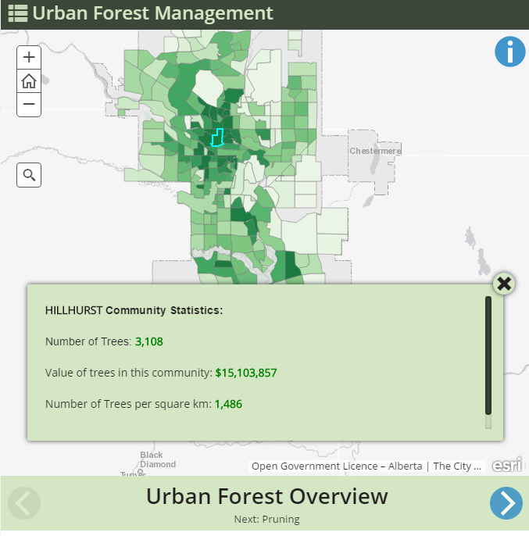
smart cities
Notes:
I’m interested in what I see as a gap in research connecting smart cities with open data platforms. Namely, both open data and smart cities elicit struggles – a politics – around how people, places, and ideas come to be encoded as data. This includes data absences across the city, and who is included and excluded; but also the forms of knowledge considered "legitimate" for open data platforms, and the dimensions or attributes that come to be "counted". As you probably suspect, this research borrows liberally from critical, participatory, and feminist GIS, while rearticulating those principles to account for the new processes occurring in open data platforms.
Because as we've already heard this morning, and as we were probably already aware, smart cities initiatives are generally conceptualized partly as the collection, analysis, visualization, and governance by increasingly large, complex datasets generated by infrastructures of networks, sensors, and individuals.

Slide 4
smart cities
&
open data
Notes:
And smart cities have found a serendipitous co-conspirator in open data platforms. Recently a few, Sarah Barns, Rob Kitchin, Jonathan Gray, and others have begun to chart the ways open data platforms are increasingly becoming a strategy - a tool - for cities to become "smarter". Platforms and private companies such as Socrata, OpenGov, and Azavea, claim that

Slide 5
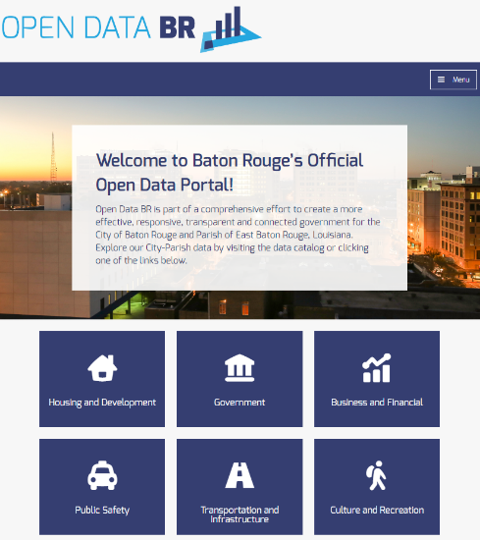
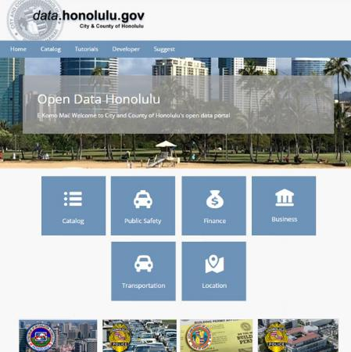
https://data.brla.gov/
https://data.detroitmi.gov/
https://data.honolulu.gov/
Notes:
"smart" entails using somewhat predictable templates,

Slide 6
smart cities
&
open data
Notes:
to increase city government accountability, transparency, as well as the generation of unexpected insights through data analytics. So in the research

Slide 7
smart cities
&
industry
open data
Notes:
there’s this strong focus on industry, and for many good reasons. But synthesizing across a few small pockets of literature, it's clear that open data signals a unique shift in urban governance centered on

Slide 8
smart cities
&
industry
empiricism
open data
Notes:
an empiricist epistemology. That is, as we understand it, interpersonal, communal, and relational ways of knowing the world are closed off from open data platforms. Tying all this together, a central theme of research on the geographies of technology is

Slide 9
smart cities
&
industry
empiricism
open data
knowledge politics
Notes:
the politics and struggles behind how knowledge, places, and people come to be encoded as data; yet this theme to date hasn't taken explicit hold of much research on open data. Clearly, as has been shown by many, including Thatcher, Dalton, Tracey Lauriault, dana boyd, and Kate Crawford, data are never neutral or raw - they always give us insights into *what matters* -- what we care about gets measured, and interrogating what gets measured tells us a little bit about what we care about.
My intervention into the relation between open data and smart cities orients toward understanding how new politics and governance are produced in and through open data platforms AND THEIR ENCODING OF SPATIAL PHENOMENA AS DATA. How and in what ways do some people leverage data writ large to influence city politics via open data platforms? (data models, categorization schema, database design, etc.) This is a question of the types of inequalities and power relations open data platforms produce and maintain, but also of how open data platforms might enact new possibilities for political interventions. [[5:00]]
For the rest of my time with you today, I will cover three empirical outcomes from this research so far, and offer some reflections on the ways in which they speak back to current theorizations of the smart city.

Slide 10
1. “municipalities are reclaiming that term, by the way…” – Jean, personal interview
Notes:
First, how are we to understand the quote that opened this talk? “Municipalities are reclaiming that term, by the way…”? By digging deeper in my conversation with Jean that day, it became clear that what she means by this quote is that Calgary is part of what she sees as a growing movement that is responding to trends that have dominated smart cities discourses. Most importantly, she’s referring to the role of the private sector – for example, Socrata and OpenGov. She expects that what she observes in other cities will be duplicated in Calgary. For example, she interprets Boston specifically to have said,

Slide 11
“don’t send us your vendors and platforms; instead, show us you’ve spoken with our communities.”
Notes:
“Don’t send us your vendors and platforms; instead, show us you’ve spoken with our communities.”
Now, of course, on the one hand you can dismiss this as the sort of hand-waving governments at all scales inevitably engage in. In a sense, she has to say this even if smart cities first and foremost serve the interests of capital. And I need to be clear here: it’s obvious that they do indeed serve the interests of capital. But on the other hand, the more important point is that this is how she interprets shifts in the field. In other words, this reminds us that cities enact data politics to a degree self-reflexively. As is the case throughout the history of urban planning, from the City Beautiful movement to the rational modernists to new urbanism, cities react to the sorts of insights and problematics brought to their attention. In a similar vein, my colleague Victoria Fast has observed that Columbus, Ohio distinguished themselves to win the US’s 2016 smart city challenge largely by focusing on issues of accessibility.
The question is what sorts of data politics emerge in this new, slightly “evolved” smart city? Can smart cities research account for the ways in which this self-reflexivity and adaptation manifest in different data politics across the globe?

Slide 12
2.looking outward
Notes:
Second, and very much related to the previous point, the city of Calgary actively and expressly looks to other cities to adapt and localize policies like “smart cities”. For example, I spoke with

Slide 13
http://www.calgary.ca/cfod/it/Pages/Digital-strategy.aspx
Notes:
one of the authors of the city’s digital strategy, by the pseudonym “Diana”. The impetus for the interview was the fact that the city’s digital strategy does not even use the term “smart”, let alone “smart city”, despite being adopted in 2014.

Slide 14
“Moving to an information-centric approach challenges The City to find effective ways to manage large volumes of data, overcome storage and retention issues, and understand the staffing needs required to transform data into usable information.”
http://www.calgary.ca/cfod/it/Pages/Digital-strategy.aspx
Notes:
In many other ways, it’s quite reflective of what you’d find in most other smart cities policies around the world – with use of terms and phrases like X, Y, Z.
So, Diana explained the digital strategy to me in terms of how she interprets the shifting winds of buzzwords around digital technology. She listed no fewer than 4 North American cities whose digital strategies they closely interrogated prior to writing theirs. She contends somewhat tongue-in-cheek that “open government” was more the rage when they wrote their digital strategy, but more seriously claims that the authors struggled quite hard around language, ultimately adopting the language in use in other cities at the time.

Slide 15
2.looking outward
policy mobilities?
Notes:
This draws us into the rich body of literature that looks at how policies leap geographic boundaries – how policies are marketed as “working” in some places and then take different form when applied in a different place. I’m thinking of course about the policy mobilities literature covered quite thoroughly by Harriet Bulkeley, Jamie Peck, Eugene McCann and others.
At the same time, both Diana and Jean told me that all the pieces of Calgary’s incipient smart city are already present; that any growing interest in that term proper is in direct and causal relationship to

Slide 16
2.looking outward
policy mobilities?
Canada’s smart city challenge
Notes:
Canada’s smart city challenge and the funds and prestige they promise the winner. In other words, the Calgary smart city is responsive to scalar political-economic structures of funds, in this particular case one that encapsulates many of the common traits of the neoliberal state.
Of course, both of these points have implications for the types of data the city features on its open data platform.

Slide 17
3. grassroots politics framing open data
Notes:
Third, and lastly, open data platforms entail a politics surrounding the types of data released on the open data platform. And I mean this in two ways. The more obvious one is in the decision-making practices behind some very important datasets

Slide 18
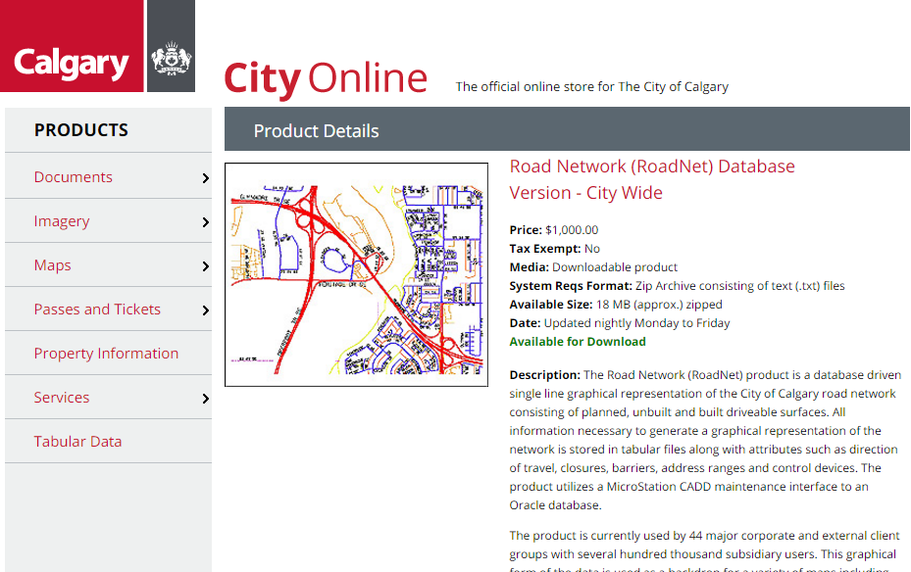
https://cityonline.calgary.ca/Pages/Product.aspx?category=&cat=&id=0004-11661-14294-00028-P
Notes:
such as the city roads, remaining for sale for

Slide 19
https://cityonline.calgary.ca/Pages/Product.aspx?category=&cat=&id=0004-11661-14294-00028-P
Notes:
$1000 CAD, rather than going on the open data platform as is more common in other cities. This came to my attention after a student pointed out to me that it had been actively removed from the open data platform; after which I,

Slide 20
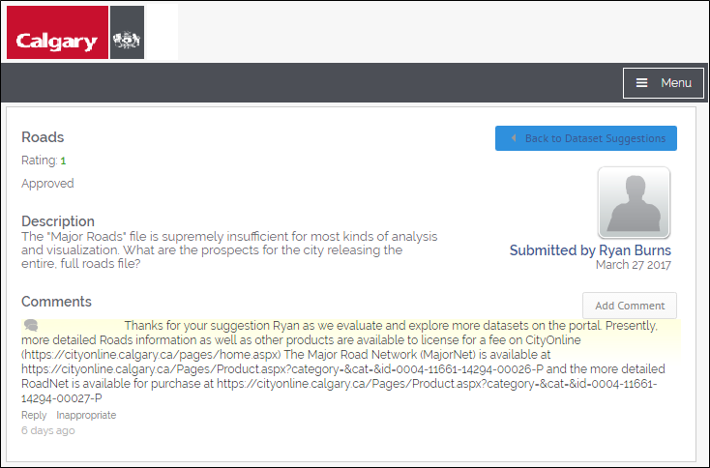
https://cityonline.calgary.ca/Pages/Product.aspx?category=&cat=&id=0004-11661-14294-00028-P
https://data.calgary.ca/nominate/6900
Notes:
the caring teacher I am, promptly chastised the city on their citizen dashboard for doing so, and was

Slide 21
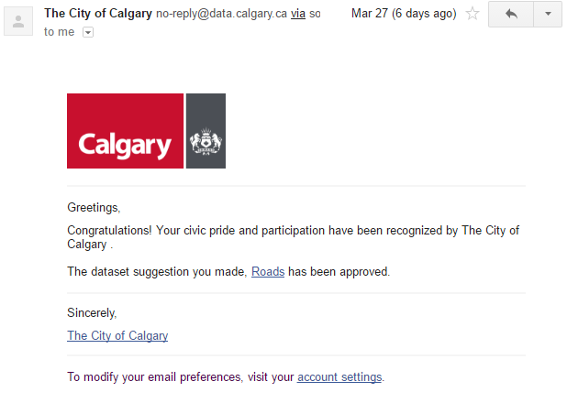
https://cityonline.calgary.ca/Pages/Product.aspx?category=&cat=&id=0004-11661-14294-00028-P
https://data.calgary.ca/nominate/6900
Notes:
accordingly thanked for my civic pride via email.

Slide 22
3. grassroots politics framing open data
Notes:
But more importantly, what I mean by this point is that the city does not consider data generated by citizens and civil society organizations. According to my interviewee Graham, who works on the open data platform, the city is not opposed to collecting this data; it is just unequipped to do so. I expect it had rarely crossed their minds, too, because after our interview

Slide 23
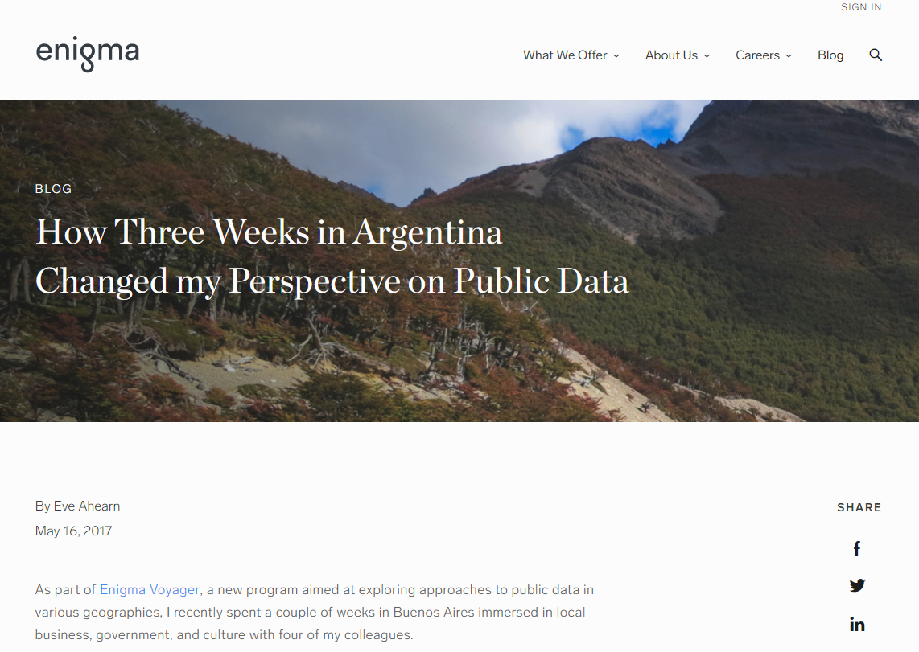
https://www.enigma.com/blog/how-3-weeks-in-argentina-changed-my-perspective-on-public-data
Notes:
Graham sent me a link to what he characterized as an interesting article on why governments should collect grassroots-generated, geoweb sorts of data.
And that’s a key direction in which my research is headed at the moment – to look at data community organizations, neighborhood associations, and citizens generate to express sometimes non-empiricist, sometimes non-Euclidean, sometimes very deeply personal and emotional ways of knowing their city.
Again, this concern is about more than *what* gets counted and is instead about the ways in which phenomena come to be captured as data. What qualities get captured, and how are they measured, processed, represented, analyzed, and interpreted? Examples abound of these sorts of projects in critical and feminist GIS, as well as the geoweb.

Slide 24
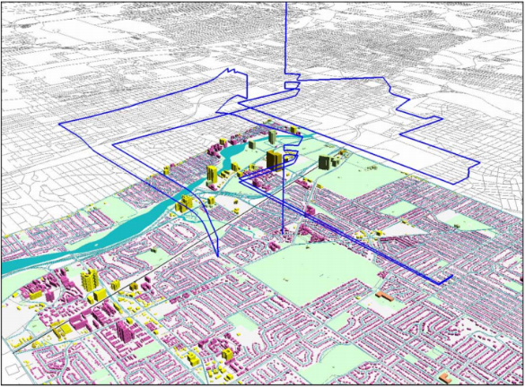
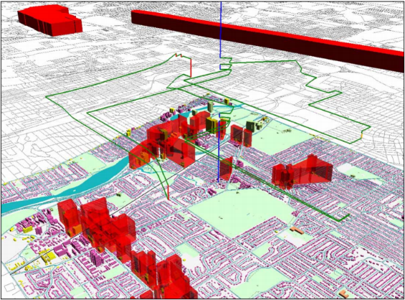
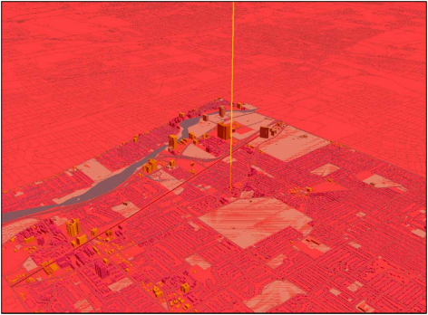
what counts as data?
problem-framing, quantification, and
digital divide
the subjects of smart cities
who benefits from techno-utopias?
Kwan, M.-P. 2008. From Oral Histories to Visual Narratives… Social and Cultural Geography.
Notes:
For example, we can imagine the political import of including in Open Calgary a dataset similar to that of Mei-Po Kwan's visualization of Muslim women's space-time paths after September 11, 2001.

Slide 25
http://128.95.212.135/
Sarah Elwood and Katharyne Mitchell, Mapping Youth Journeys.
Notes:
Or of this dataset created in a children's participatory course on racial and ethnic histories in Seattle. I participated in this project with Sarah Elwood and Katharyne Mitchell in Seattle, and would be happy to speak more about it in the Q&A or after this session. This sort of work remains a gap in open data research.

Slide 26
open data → smart cities?
https://www.flickr.com/photos/americanartmuseum/23726764161
in conclusion
Notes:
In conclusion, I want to underscore that the relationships between open data platforms and smart cities are complex and under-explored. In the nascent project I have outlined here,

Slide 27
open data → smart cities?
https://www.flickr.com/photos/americanartmuseum/23726764161
reclaiming the “smart city”
in conclusion
Notes:
I am finding that smart cities can be reflexive, and have argued that smart cities can benefit from looking at the types of data politics that emerge in the context of this reflexivity.

Slide 28
open data → smart cities?
https://www.flickr.com/photos/americanartmuseum/23726764161
reclaiming the “smart city”
in conclusion
looking outward
Notes:
This reflexivity partly stems from a strong “looking outward” that asks us to draw on policy mobility literature and to remember the importance of structural and scalar economics.

Slide 29
open data → smart cities?
https://www.flickr.com/photos/americanartmuseum/23726764161
reclaiming the “smart city”
in conclusion
looking outward
absences in open data
Notes:
And lastly, I underscore that grassroots, geoweb sorts of data, while currently marginalized from open data platforms, hold immense political promise.

Slide 30
thank you for your time and attention
https://www.flickr.com/photos/americanartmuseum/23726764161
Ryan Burns
University of Calgary
ryan.burns1@ucalgary.ca
http://burnsr77.github.io

