Slide 1
Welcome to Urban Geographic Information systems!
Dr. Ryan Burns
Department of Geography
Fall 2016
burnsr77@gmail.com
Notes:
I would normally provide a bit of an introduction about myself – where I come from, my background with urban GIS, my research interests, and so on. For the purposes of this lecture I’ll skip over this.

Slide 2
poll:
have you…

Slide 3
poll:
have you…
computer

Slide 4
poll:
have you…
computer
internet/email

Slide 5
poll:
have you…
smart phone
(iPhone, Android, etc.)
computer
internet/email

Slide 6
poll:
have you…
smart phone
(iPhone, Android, etc.)
computer
internet/email
social media (Facebook, Twitter, Instagram, LinkedIn, Snapchat, YikYak)
Notes:
Has anyone used a social media site that’s not on this list?

Slide 7
poll:
have you…
smart phone
(iPhone, Android, etc.)
computer
internet/email
online mapping technology (Google Earth/Maps, Yelp, FourSquare)
social media (Facebook, Twitter, Instagram, LinkedIn, Snapchat, YikYak)

Slide 8
poll:
have you…
volunteer-based geographic technology (Swarm, Yelp, geotagged Tweets, Flickr, etc.)
smart phone
(iPhone, Android, etc.)
computer
internet/email
online mapping technology (Google Earth/Maps, Yelp, FourSquare)
social media (Facebook, Twitter, Instagram, LinkedIn, Snapchat, YikYak)

Slide 9
poll:
have you…
volunteer-based geographic technology (Swarm, Yelp, geotagged Tweets, Flickr, etc.)
smart phone
(iPhone, Android, etc.)
computer
internet/email
online mapping technology (Google Earth/Maps, Yelp, FourSquare)
social media (Facebook, Twitter, Instagram, LinkedIn, Snapchat, YikYak)
open-source mapping (OpenStreetMap, Ushahidi, WikiMapia, etc.)

Slide 10
background on urban GIS
administrative stuff
bringing it back together: our pressing questions
Notes:
This is what we’ll be doing today: some high-level background on urban GIS: where it’s at with data collection, analysis, and representation. Those sorts of questions.

Slide 11
background on urban GIS
administrative stuff
bringing it back together: our pressing questions
Notes:
First, let’s get a lay of the land of urban GIS.

Slide 12
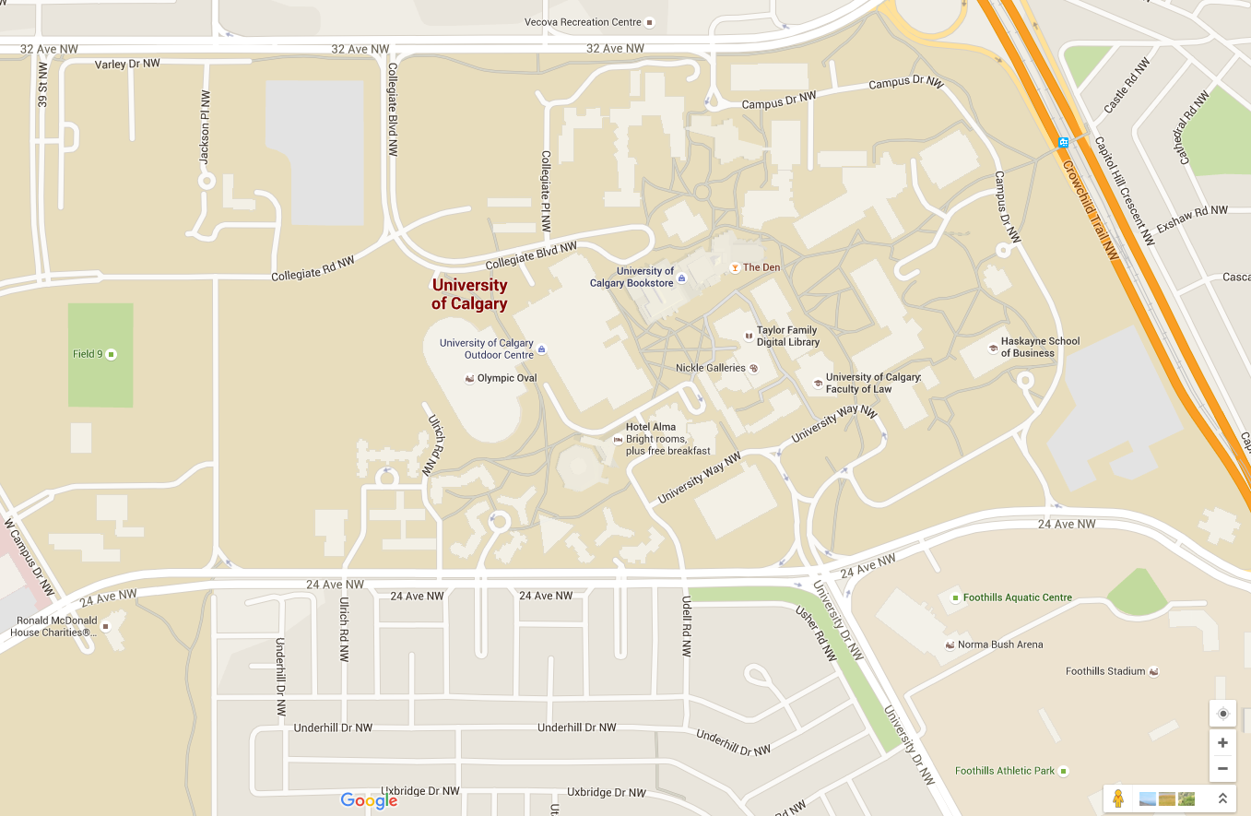
Google Maps
Notes:
I want to start a discussion about urban GIS by taking a look at this map of your campus. You’re probably already familiar with this representation of your environment because this platform is so popular. In particular, look at the bottom-left, the area just to the west and north of the Olympic Oval.

Slide 13
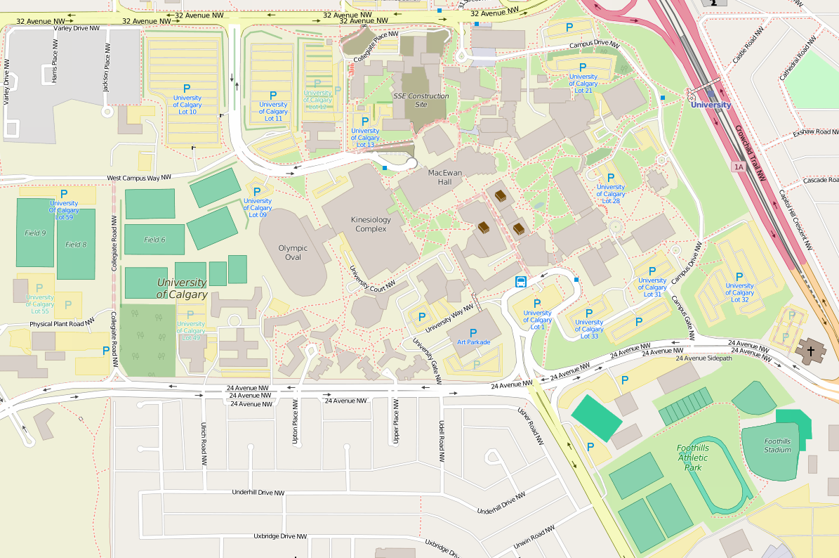
OpenStreetMap
Google Maps
Notes:
Here’s a very different representation of the same place. Still your campus, right? But a different view of what it “looks” like. OSM represents campus as having much more going on – more sports fields, more green space, and so on. When we use geographic information systems to analyze and represent urban phenomena, you see here a challenge that’s raised for us: how are we representing those urban landscapes and processes? What data types and data points do we take as inputs to an analysis of the urban form, dynamics, and lived spaces? Because maps and data make us think about urban spaces in particular ways. They produce the city just as much as they represent it.
When we look at a place like University of Calgary you might say these influences are rather banal; I happen to think that they are quite consequential, but maybe you’re unconvinced. When we look at other places with which we’re less familiar, however…

Slide 14
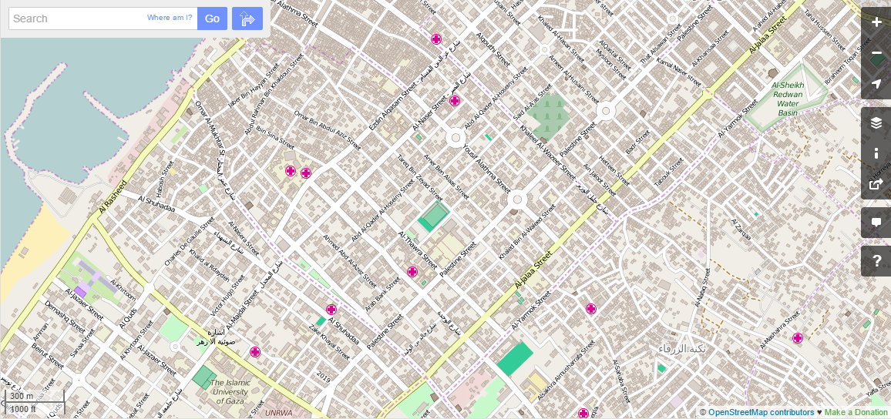
Google Maps
OpenStreetMap
Notes:
the impacts can be quite strong on our understandings of what happens in a place. take a look at these two representations of a city in the Gaza Strip, for instance. In Google Maps it appears relatively empty. Plenty of streets, and a few important sites are labeled at this scale, but quite sparse. In contrast, in OSM it appears full of, well, people. It’s densely populated, full of not just buildings but parks, clinics, and even a water basin. And of course as you’ve seen in GIS I and your urban geography courses, our analyses and representations of places impacts the way we think of them, right? This has implications for urban administration, politics, social movements, and service provision.

Slide 15
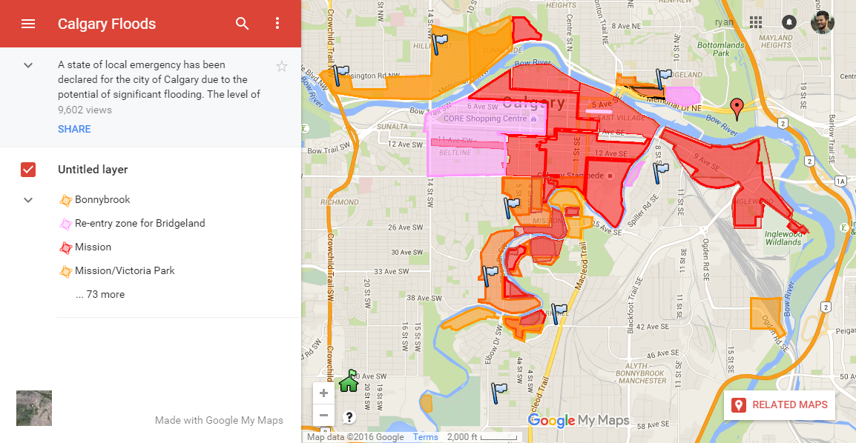
https://www.google.com/maps/d/viewer?mid=zRKUD5WlJmWI.kPu1-9RZVfB0&hl=en_US
Notes:
Let’s bring it back home again. You probably all remember the floods a couple years ago and the major disruptions they caused in the city’s normal flow. I’m guessing they probably cancelled classes for that? In any case, they were a disaster that the city needed to respond to, but in order to provide services, aid, and water containment – as well as enable citizens as much as possible to either help each other or return to their normal routines – in order to do this, they needed to know where needs were located and where the flood remained. In other words, geographic questions drive the analysis of and response to natural disasters in urban contexts.
So they have official sources of data that they’ve been using for decades, but now in 2013 new sources of data, needs, and knowledge are proliferating. So you see something like this volunteer-produced map on top of Google’s MyMaps platform.

Slide 16
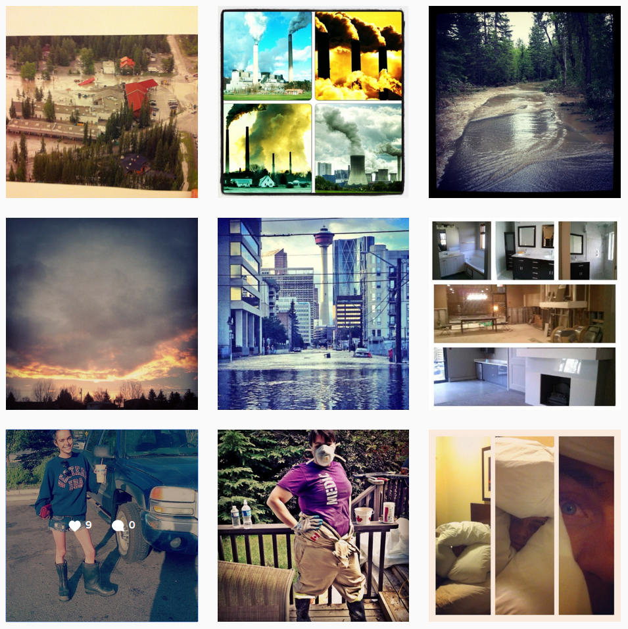
https://www.google.com/maps/d/viewer?mid=zRKUD5WlJmWI.kPu1-9RZVfB0&hl=en_US
https://www.instagram.com/explore/tags/calgaryflood/
Notes:
And you see people producing records of the floods from their smartphones and geotag-able cameras, and all of a sudden the datasets available to city administrators, emergency responders, and lay volunteers is now way vaster than in the past, and the phrase “urban GIS” means more than just datasets provided by formal, official city officials, right?

Slide 17
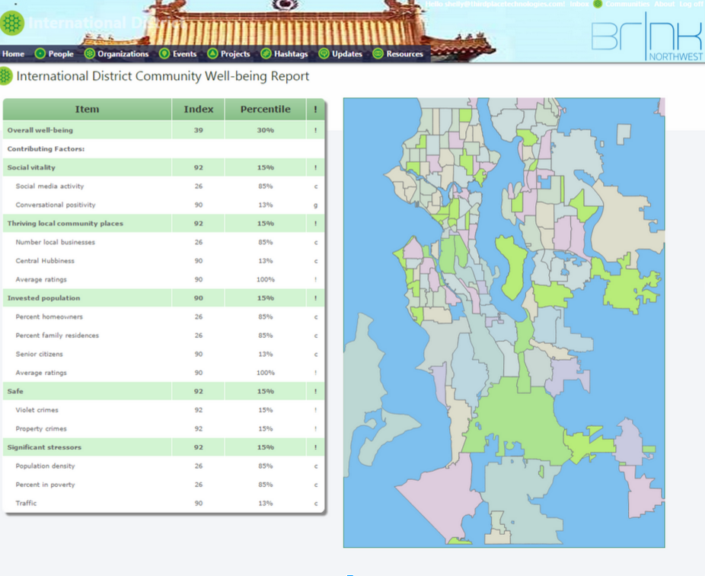
http://thirdplacetechnologies.com/introducing-spokin/
Notes:
Well let’s take that one step further, and I’m going to want to hear from you on this. This semester I’m going to be drawing a lot on a research project I participated in back when I lived in Seattle last summer. On this project we were trying to leverage some of these new datasets about cities to see if we could measure and improve community well-being in the Seattle area. You see here a map of the seattle region, where the city itself is on the left and then the surrounding cities like Bellevue and Redmond (where Microsoft is), Renton, and the airport. In the city of Seattle and city of Bellevue we have neighborhoods, but in other places we only have municipal boundaries or even boundaries drawn in by volunteers because those are the only boundaries we could find.

Slide 18
Yelp
CA Census
(and municipal census, too!)
Instagram
Notes:
We were trying to use sources of data like Yelp, Instagram, and the US Census – digging in to analyze data there to see if a community is doing “well”. But we ran into a bunch of problems related to what we can and can’t say about a city by looking at these data sources and using the administrative boundaries we used.

Slide 19
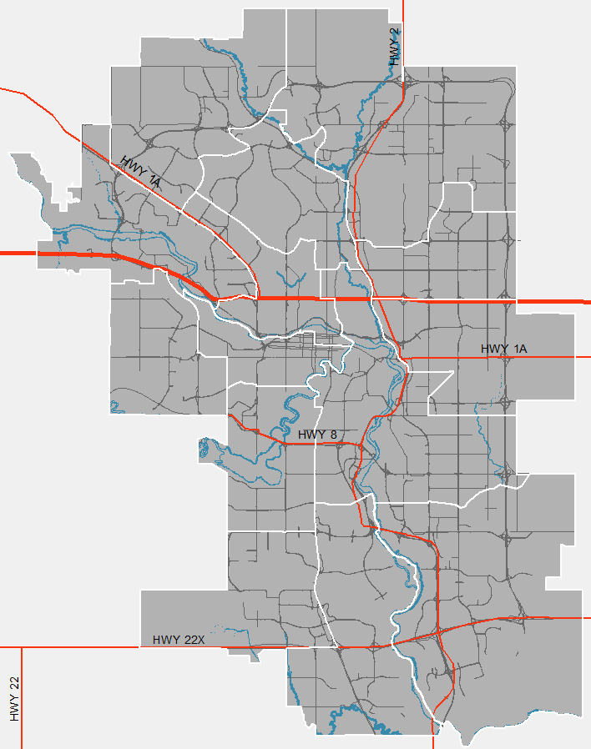
Yelp
CA Census
(and municipal census, too!)
Instagram
What can we learn about a city with this data source?
What can’t we learn about a city with this data source?
Notes:
Now, imagine we switch the city of that project to Calgary. What you see here is the city’s wards within the white outlines – they’re as close as I could find to neighborhoods! I want you all to break into small groups to discuss these questions as they relate to one of those data sources there. Basically, think about what those data sources can help us say about Calgary neighborhoods, and what they can’t say about Calgary neighrborhoods.

Slide 20
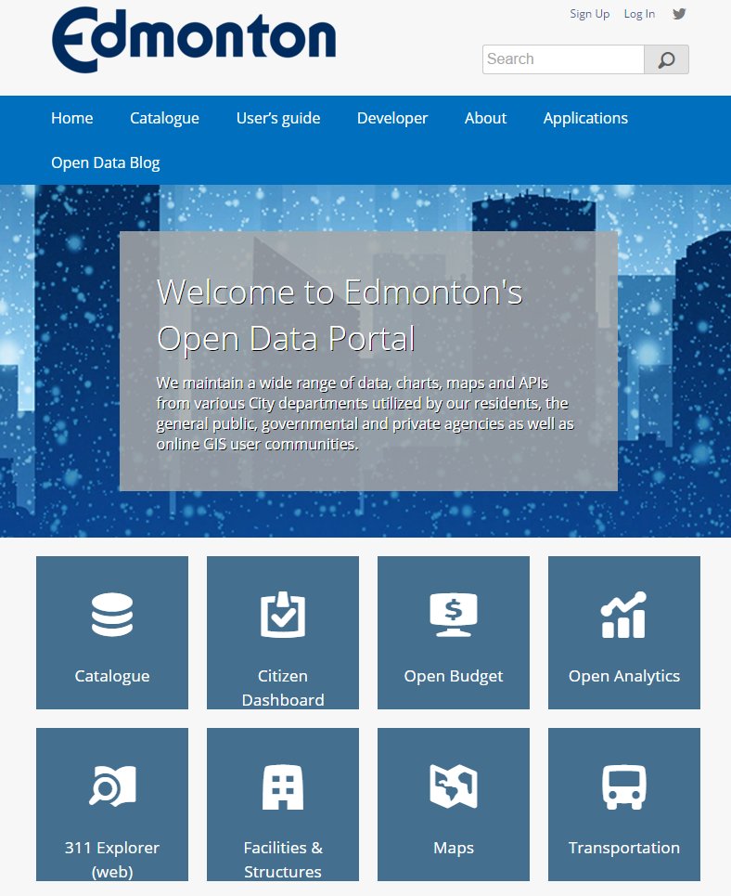
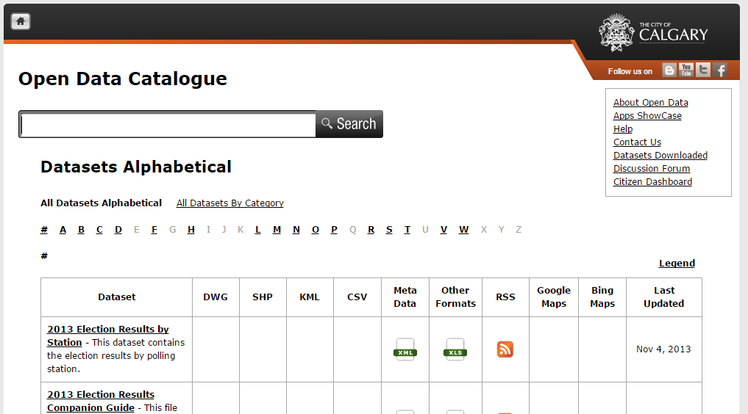
https://data.calgary.ca/OpenData/Pages/DatasetListingAlphabetical.aspx
https://data.edmonton.ca/
Notes:
And perhaps most exciting – and intellectually interesting – shifts for the field of Urban GIS is the fact that so many cities right now are jumping on the “open data” bandwagon. They’re making their datasets open, consolidated, and freely available for basically anyone with an internet connection and the software know-how to use and analyze it. This means that you can conduct GIS analyses to increase the city’s accountability, but you can also conduct original analyses and perhaps contribute to the city’s workflows. Make it a better place to live. I say this is interesting because it’s a small handful of private companies like Socrata, a Seattle-based tech company – who are providing the labor for making datasets open. And that’s what you see for Edmonton – that’s a Socrata interface. It of course raises a bunch of questions that are central to urban and human geography about the role of the private, for-profit sector in public-sector urban processes.

Slide 21
what is
urban GIS?
Notes:
And all of this ties into what, exactly, urban gis is. and that’s what I hope you will get out of this class – the rich new perspectives and transformations available to those of us who use GIS in urban contexts. It’s a tremendously exciting time to be getting involved in this field, and I hope that excitement shines through the course material.

Slide 22
using GIS to analyze, understand, and represent:
what is
urban GIS?
Notes:
by way of definition, the confluence of all these things we’ve seen is what we call urban gis:

Slide 23
using GIS to analyze, understand, and represent:
urban form, dynamics, and landscapes
what is
urban GIS?
Notes:
by way of definition, the confluence of all these things we’ve seen is what we call urban gis:

Slide 24
using GIS to analyze, understand, and represent:
urban form, dynamics, and landscapes
industrial, commercial, residential, and demographic patterns and change
what is
urban GIS?
Notes:
by way of definition, the confluence of all these things we’ve seen is what we call urban gis:

Slide 25
using GIS to analyze, understand, and represent:
urban form, dynamics, and landscapes
industrial, commercial, residential, and demographic patterns and change
environmental processes
what is
urban GIS?
Notes:
by way of definition, the confluence of all these things we’ve seen is what we call urban gis:

Slide 26
using GIS to analyze, understand, and represent:
urban form, dynamics, and landscapes
industrial, commercial, residential, and demographic patterns and change
environmental processes
and assist in city administration, planning, and management.
what is
urban GIS?
Notes:
by way of definition, the confluence of all these things we’ve seen is what we call urban gis:

Slide 27
background on urban GIS
administrative stuff
bringing it back together: our pressing questions

Slide 28
exam structure

Slide 29
exam structure
short answer

Slide 30
exam structure
short answer
problem-solving

Slide 31
LABS

Slide 32
LABS
5 total
Notes:
They are pretty straightforward: walk through some steps to accomplish a task, but while doing so, be critically reflexive. Mapmaking

Slide 33
LABS
5 total
advanced GIS skills
Notes:
They are pretty straightforward: walk through some steps to accomplish a task, but while doing so, be critically reflexive. Mapmaking

Slide 34
LABS
5 total
2 weeks of lab time
advanced GIS skills

Slide 35
community project

Slide 36
Center for Community-Engaged Learning:
Calgary Urban Project Society (CUPS)
Grow Calgary
Between Friends
Bethany Care
Ann & Sandy Cross Conservation Area (ASCCA)
Wildwood Garden
community project

Slide 37
2 per project
Center for Community-Engaged Learning:
Calgary Urban Project Society (CUPS)
Grow Calgary
Between Friends
Bethany Care
Ann & Sandy Cross Conservation Area (ASCCA)
Wildwood Garden
community project

Slide 38
2 per project
Center for Community-Engaged Learning:
Calgary Urban Project Society (CUPS)
Grow Calgary
Between Friends
Bethany Care
Ann & Sandy Cross Conservation Area (ASCCA)
Wildwood Garden
organization-led
community project

Slide 39
2 per project
Center for Community-Engaged Learning:
Calgary Urban Project Society (CUPS)
Grow Calgary
Between Friends
Bethany Care
Ann & Sandy Cross Conservation Area (ASCCA)
Wildwood Garden
organization-led
presentation & paper
community project

Slide 40
2 per project
Center for Community-Engaged Learning:
Calgary Urban Project Society (CUPS)
Grow Calgary
Between Friends
Bethany Care
Ann & Sandy Cross Conservation Area (ASCCA)
Wildwood Garden
organization-led
presentation & paper
community project
project descriptions at front – list 3 priorities!

Slide 41
background on urban GIS
administrative stuff
bringing it back together: our pressing questions

Slide 42
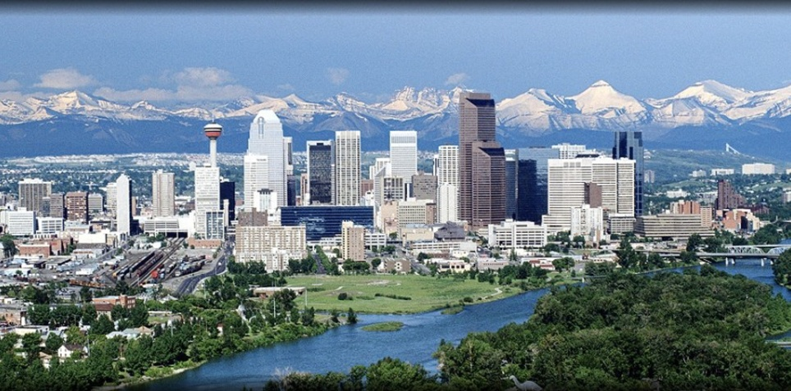
http://www.cija.ca/near-you/calgary/
what is ‘the urban’?
Notes:
W

Slide 43
http://www.cija.ca/near-you/calgary/
what is ‘the urban’?
what makes this GIS urban?
Notes:
W

Slide 44
what can urban GIS tell us about society, nature, politics, and economy?
http://www.cija.ca/near-you/calgary/
what is ‘the urban’?
what makes this GIS urban?
Notes:
what gets represented and analyzed is that which we care about. in that way, gis is an act of caring.

Slide 45
social construction of data
http://gking.harvard.edu/publications/preface-big-data-not-about-data
https://www.iop.org/resources/topic/archive/society/page_66049.html
Notes:
this semester we’ll be guided by the idea that data are not purely technical – that data are always curated, collected selectively, isolated from their contexts, and very much linked with social concerns. in that way, there’s no such thing as ‘raw data’
additional to the data themselves, there are social and political concerns around access, use, implications are determined by more than the just the technologies themselves
data and society play off each other and come into conversation with each other, and we call this the ‘social construction of data’.

Slide 46
‘raw data’
social construction of data
http://gking.harvard.edu/publications/preface-big-data-not-about-data
https://www.iop.org/resources/topic/archive/society/page_66049.html
Notes:
this semester we’ll be guided by the idea that data are not purely technical – that data are always curated, collected selectively, isolated from their contexts, and very much linked with social concerns. in that way, there’s no such thing as ‘raw data’
additional to the data themselves, there are social and political concerns around access, use, implications are determined by more than the just the technologies themselves
data and society play off each other and come into conversation with each other, and we call this the ‘social construction of data’.

Slide 47
‘raw data’
social construction of data
access, use, implications
http://gking.harvard.edu/publications/preface-big-data-not-about-data
https://www.iop.org/resources/topic/archive/society/page_66049.html
Notes:
this semester we’ll be guided by the idea that data are not purely technical – that data are always curated, collected selectively, isolated from their contexts, and very much linked with social concerns. in that way, there’s no such thing as ‘raw data’
additional to the data themselves, there are social and political concerns around access, use, implications are determined by more than the just the technologies themselves
data and society play off each other and come into conversation with each other, and we call this the ‘social construction of data’.

Slide 48
critical GIS
social construction of data
‘raw data’
access, use, implications

Slide 49
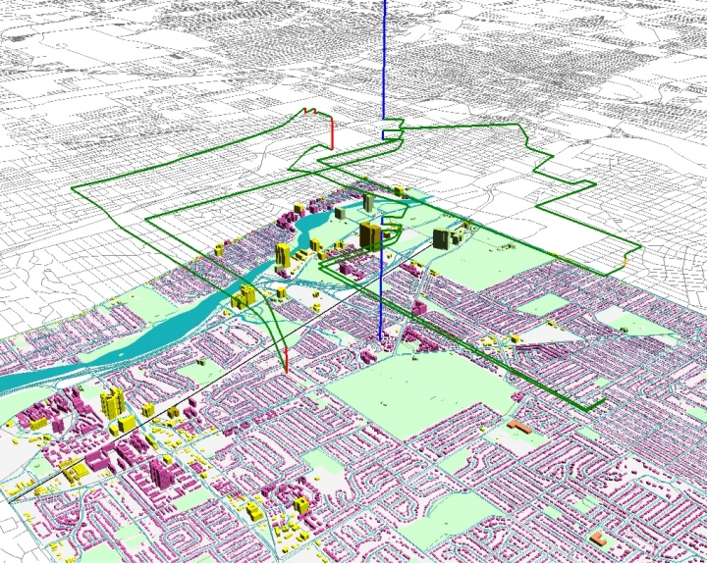
any questions?
Dr. Ryan Burns
Department of Geography
Fall 2016
burnsr77@gmail.com
http://meipokwan.org/Gallery/STPaths.htm

